Slide 1

CG1112
Engineering Principles and Practices II for CEG
Week 4 Studio 1
Interrupts
colintan@nus.edu.sg

Slide 2
Dealing With I/O
Earlier you learnt about programming the GPIO ports on the AVR microcontroller unit (MCU) used on the Arduino.
In this lecture we will look at a related topic: Interrupts.

Slide 3
Dealing With I/O
Presumably you are currently using your laptop/PC to view this set of slides, and maybe listen to my lecture.
So your PC is busy:
Rendering the gorgeous colors and wise words of these slides.
Playing my recording of these notes.
Presumably, your computer still responds to your keyboard!
You can try hitting ESC or ALT-TAB to see if you can escape these notes!

Slide 4
Dealing With I/O
Question:
Since your PC is busy showing these slides or playing a video (or Goat Simulator, if you’re inclined towards such things):
HOW DOES YOUR PC KNOW WHEN YOU HAVE PRESSED A KEY??
Long story short, there are two possibilities:
Your computer (actually, your operating system – but we’ll wait till CG2271 to talk about that) continuously checks if a key has been pressed. OR
The keyboard tells the CPU when a key has been pressed, and the CPU goes and reads the key.

Slide 5
An Analogy
Consider this story:
Elon the Magnificent, one time CEO of PayPal, founder of Tesla Motors and SpaceX, and Awesome Superhero ™, wants to employ you to the hedges in his Awesome Superhero ™ Secret Hideout ™ at the Basement of 1 Infinite Loop, Cupertino, CA 95014.
He will pay you US$25m a year, in perpetuity.
Would you take this job? (Say YES! C’mon trimming hedges in a basement for the Awesome Superhero ™ has to be better than reading these slides!)

Slide 6
An Analogy
There a catch! (Aside from the fact that nobody grows hedges in basements):
He will call you on your land-line phone to talk to you first (little known fact: Elon does not like mobile phones).
You must answer in three seconds, or the job goes to your worst enemy, and you have to pay your worst enemy US$2m.
You’re busy with EPP2 readings and studios.
What would you do if:
Your phone’s ringer doesn’t work?
Your phone’s ringer works perfectly?

Slide 7
I/O Programming
There are 3 ways to access the I/O devices. The Arduino/AVR does not support the third method (direct memory access) so we will skip it.
Polling (You with a broken ringer)
Interrupt-driven I/O (You with a fully functioning phone)
Direct Memory Access (Not you)

Slide 8
I/O Programming Polling
This is the simplest form of I/O programming – The CPU does all the work.
Consider a process that prints “ABCDEFGH” on the printer:
User process acquires the printer by making a system call. This call returns an error or blocks if the printer is busy, until it is available.
There is an operating system (OS) that copies the string to be printed into its own buffer.

Slide 9
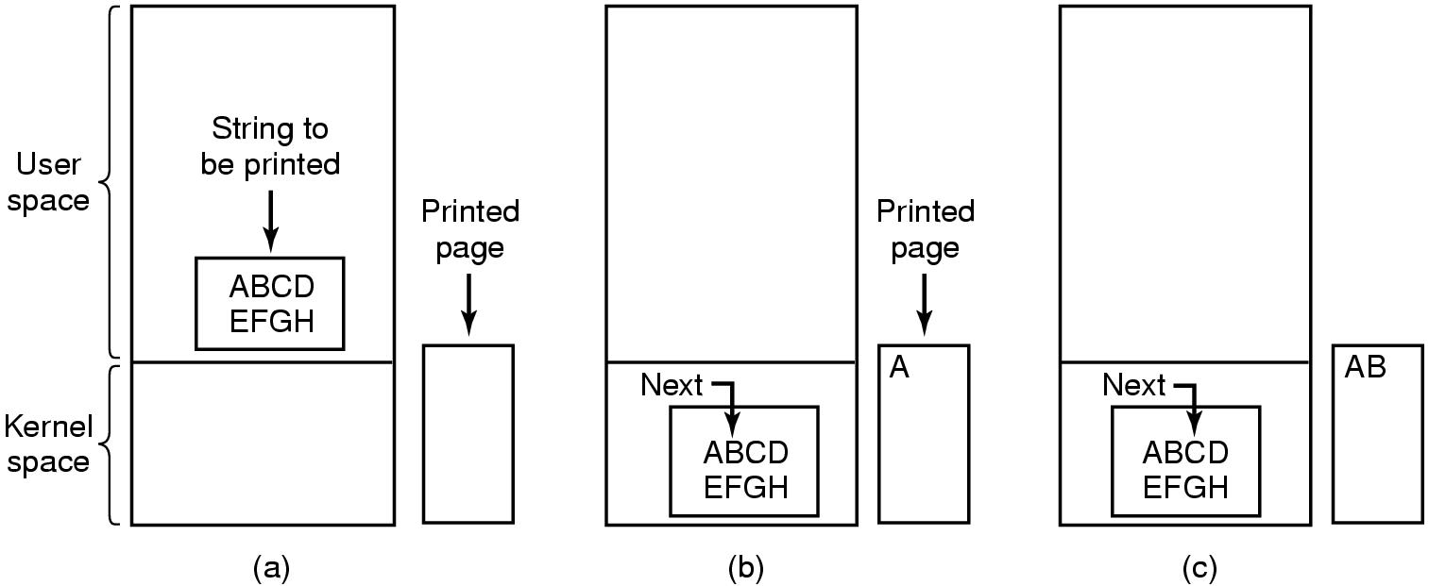
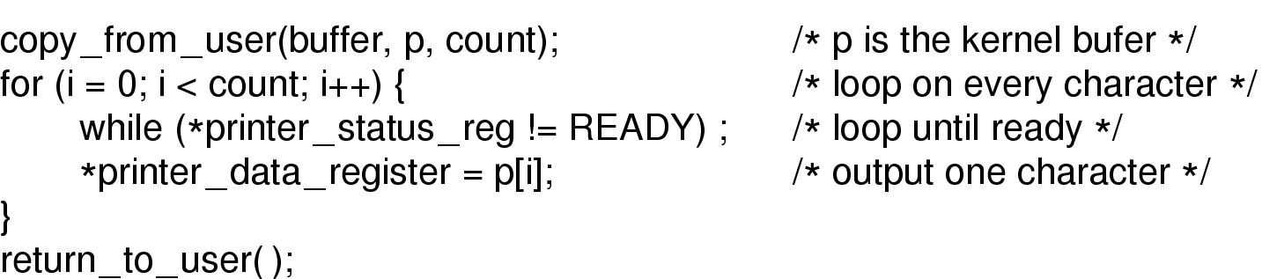
I/O Programming Polling

Slide 10
I/O Programming Polling
The OS then copies character by character onto the printer’s latch, and the printer prints it out.
Copy the first character and advance the buffer’s pointer.
Check that the printer is ready for the next character. If not, wait.
This is called “busy-waiting” or “polling”.
Copy the next character. Repeat until buffer is empty.

Slide 11
I/O Programming Polling
Issue:
It takes perhaps 10ms to print a character.
During this time, the CPU will be busy-waiting until the printer is done printing.
On a 16MHz processor like the AVR Atmega328P on the Arduino, this is equivalent to wasting 160,000 instruction cycles!

Slide 12
Polling Arduino Wiring Language Example
#define inputPin 2
…
void loop()
{
while(1)
{
// When pin 2 is HIGH we know
// data is available at
// analog input A0.
while(!digitalRead(inputPin)) ;
data=analogRead(0);
// process data
...
}

Slide 13
I/O Programming Interrupt I/O
Since 160,000 instructions is a large number, why not let the CPU do other stuff while the printer is busy?
After the string is copied, the OS will send a character to the printer, then switch to a task.
When the printer is done, it will interrupt the CPU by asserting one of the “interrupt request” (IRQ) lines on the CPU.
This triggers a software routine called an “interrupt handler” , “interrupt service routine” or “interrupt service procedure” which will then load the next character. We will use the term “ISR” – short for “Interrupt Service Routine”.

Slide 14
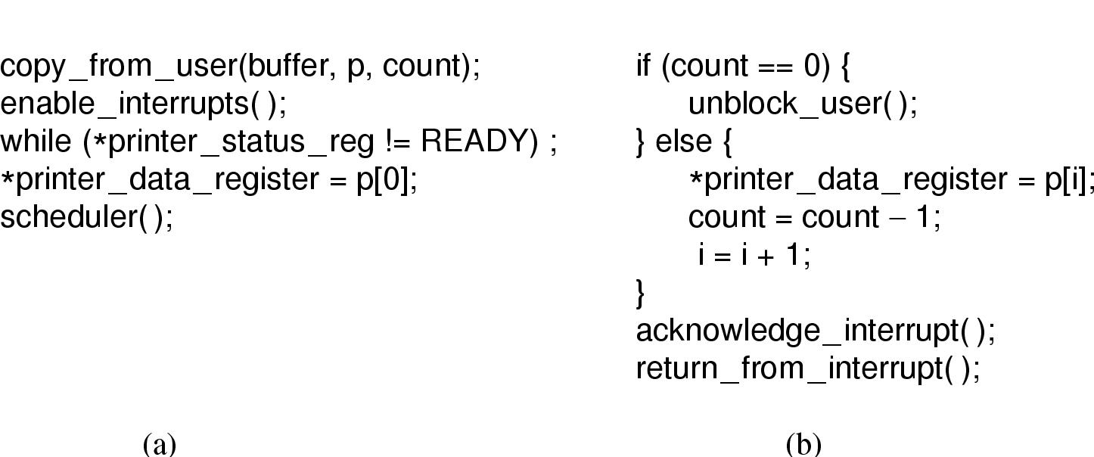
I/O Programming Interrupt I/O
Main Routine
Interrupt Service Routine (ISR)

Slide 15
Interrupt Programming on the Arduino Wiring Language
You can use attachInterrupt to specify an ISR to process interrupts.
The UNO can receive interrupts on pins 2 and 3 (INT0 and INT1).
attachInterrupt(digitalPinToInterrupt(pinnum),
function, mode)
pinnum: Either 2 (pin 2) or 3 (pin 3)
function: ISR to call when interrupt is triggered.
mode: LOW, CHANGE, RISING, FALLING.

Slide 16
Interrupt Programming on the Arduino Wiring Language
#define outputPin 13
// Interrupt 0 is on pin 2
#define inputInterrupt 0
volatile unsigned int data;
volatile unsigned char flag;
void setup()
{
pinMode(outputPin, OUTPUT);
attachInterrupt(digitalPinToInterrupt(
inputInterrupt), readAnalog,
CHANGE);
}
void readAnalog()
{
data=analogRead(0);
flag=1;
}
void loop()
{
while(1)
{
if(flag)
{
processData(data);
flag=0;
}
// Do other stuff
}
}
int main()
{
setup();
loop();
return 0;
}

Slide 17
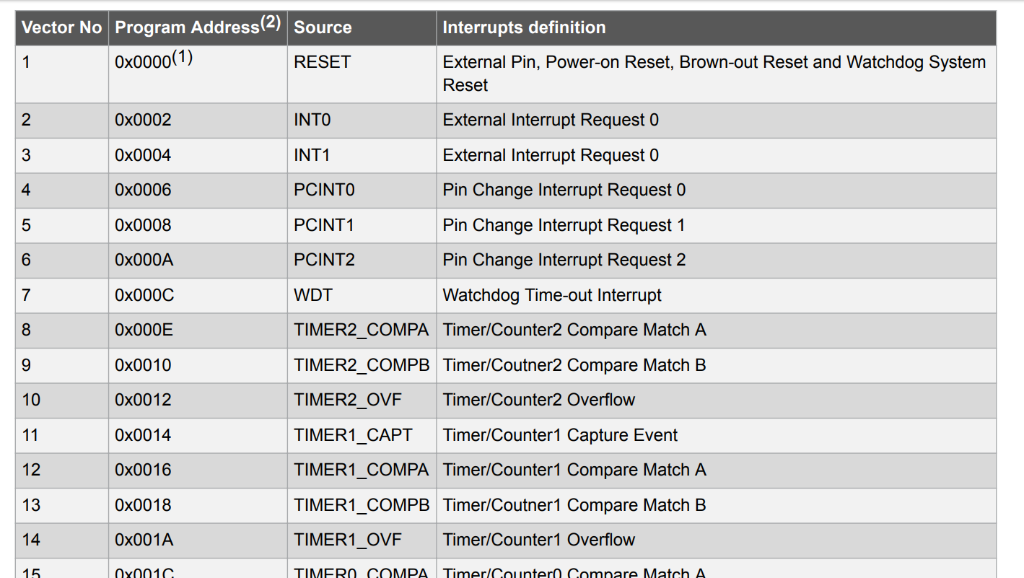
Bare-metal AVR Interrupt Programming
The Atmega328P MCU can process up to 26 different interrupts, partially shown below:

Slide 18
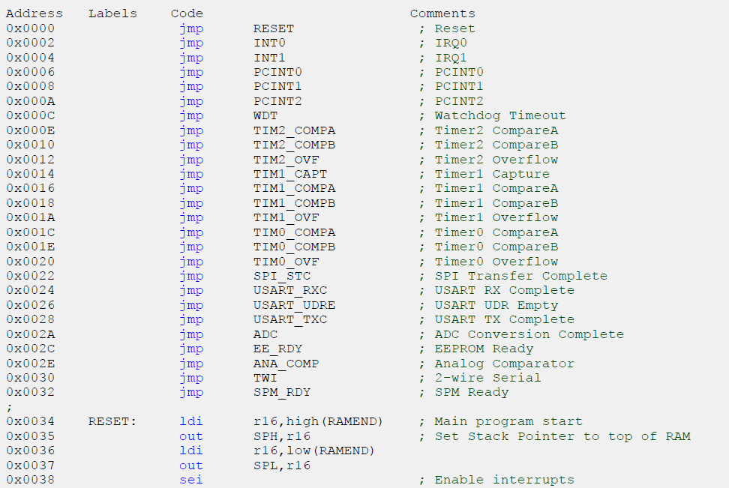
How AVR Interrupts Work The Vector Table
When an interrupt is triggered (e.g. from the timer or an external interrupt), the AVR uses a vector table (shown here) to executed the correct handler routine.

Slide 19
Bare-metal AVR Interrupt Programming
You can handle an interrupt request by using the ISR macro:
ISR(vector)
{
ISR Code
}
The vector parameter specifies the interrupt you want to process.
It takes the form interruptName_vect
E.g. to handle the PCINT0 interrupt, you would specify PCINT0_vect in vector.

Slide 20
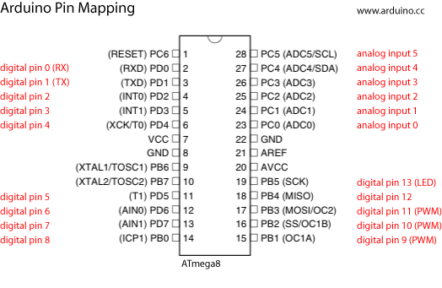
Bare-metal AVR Interrupt Programming
Arduino pins 2 and 3 are connected to INT0 and INT1, as shown in this diagram.
In the previous table, we can see that INT0 and INT1 are external interrupts.

Slide 21
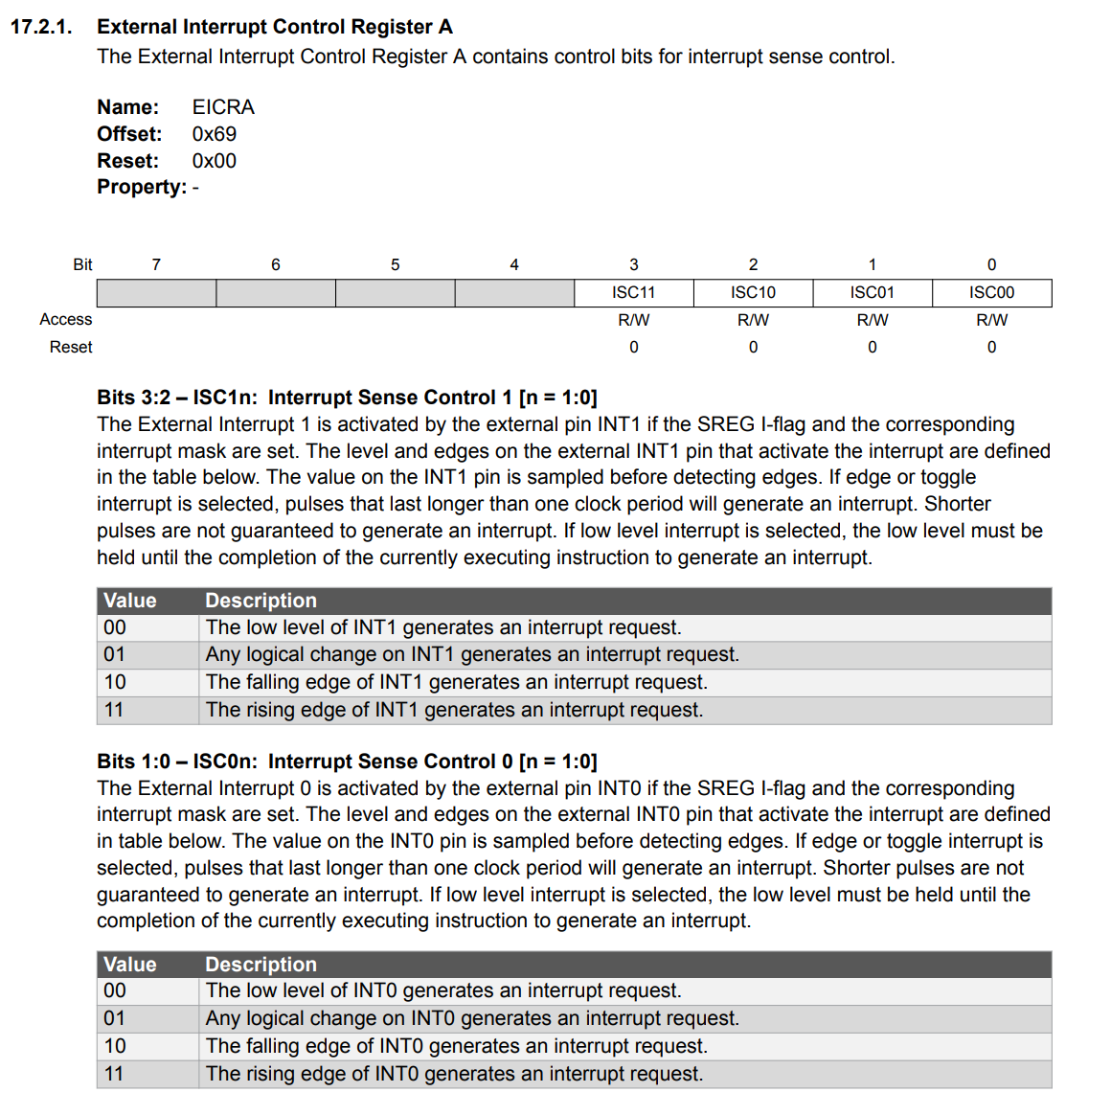
Bare-metal AVR Interrupt Programming
Both INT0 and INT1 can be configured in how they respond to interrupt requests:
This is done by settings bits 3 and 2 for INT1, and 1 and 0 for INT0 of the EICRA register, according to the table on the right.

Slide 22
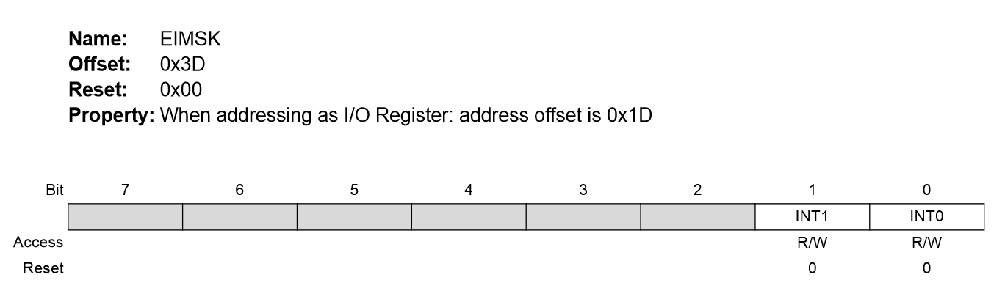
Bare-metal AVR Interrupt Programming
By default, INT0 and INT1 are turned off. To turn them on, you need to write to bits 0 and 1 respectively of register EIMSK (External Interrupt Mask Register):

Slide 23
Interrupt Masking
The MCU can be made to ignore almost all interrupts. This is called “interrupt masking”.
This is used in critical segments of code where any interruption can result in wrong execution.
How to disable/enable interrupts:
On Arduino Wiring Language:
noInterrupts() to disable all interrupts.
interrupts() to enable all interrupts again.
On bare-metal:
cli() to disable all interrupts.
sei() to enable all interrupts again.

Slide 24
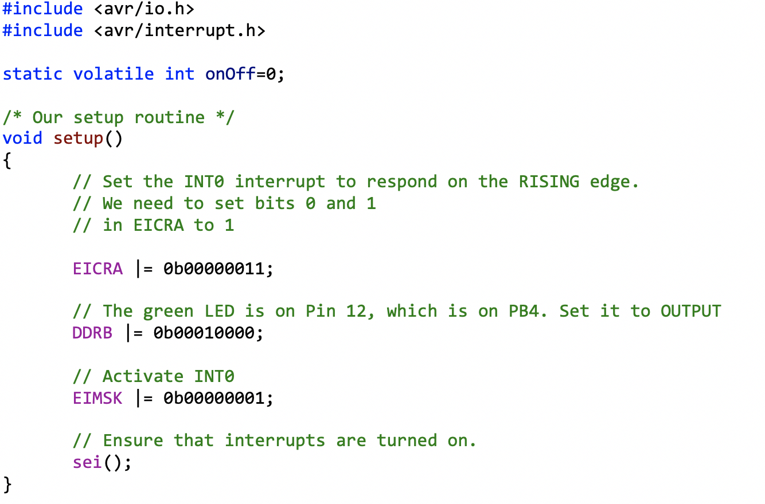
Bare-metal AVR Interrupt Programming
Example code in C: Using INT0 to switch and LED on and off.

Slide 25
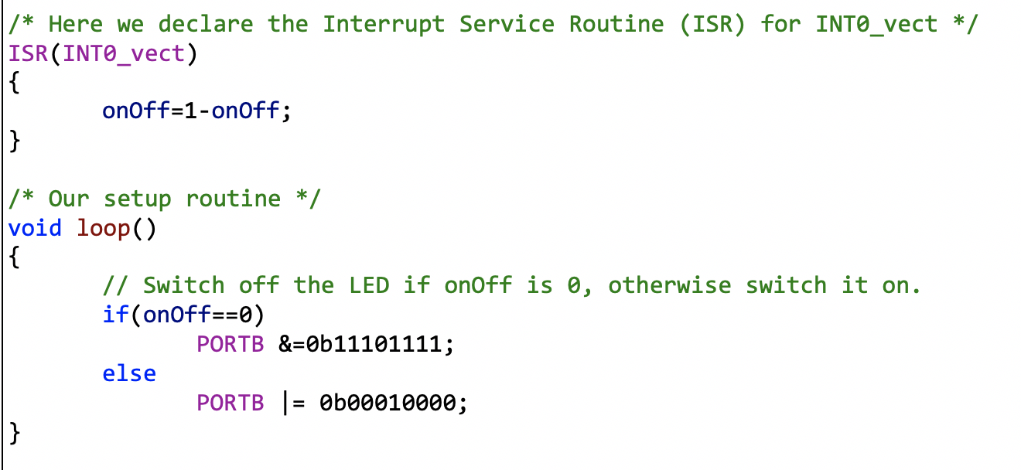
Bare-metal AVR Interrupt Programming

Slide 26
Being Volatile
For correct program operation, any global variable that is modified by an ISR but used by another function, must be declared to be “volatile”.
In our example onOff is set/cleared by the ISR but used in main, so we declare:
static volatile int onOff;
The “static” keyword is optional, and it prevents other C modules from accessing/modifying onOff, which it could otherwise do simple by declaring:
extern int onOff;

Slide 27
Why Volatility Matters
To understand volatility, we need to understand how C compiles a loop into assembly.
Where we have:
while(onoff == 0)
{
… Loop Body …
}
On CPUs like the Sun SPARC and MCUs like the ARM and AVR, the CPU can only operate on small temporary storage units called “CPU registers”, and not on variables directly.

Slide 28
Why Volatility Matters
So in the code above, the CPU/MCU loads up onOff into a register using a lw (load-word) assembly instruction and generates the following code:
lw $r0, onOff ; Load onOff into register r0
loop:
… Loop Body …
beq $r0, 0, loop ; Jump back to loop if $ro is 0
We see that the compiler does not do lw $0, onOff on every iteration but only once.
This is because memory is very slow and the lw instruction consumes a lot of CPU cycles.

Slide 29
Why Volatility Matters
The problem now is that if the ISR changes onOff, the code in the loop will never know because it never reloads onOff, and thus $r0 will never be updated.
The code goes into an infinite loop.
By declaring the variable to be volatile, the C compiler moves the lw into the loop, like so:
loop:
lw $r0, onOff ; Load onOff into register r0
… Loop Body …
beq $r0, 0, loop ; Jump back to loop if $ro is 0

Slide 30
Why Volatility Matters
Since the code now reloads onOff into $r0 on every iteration, the loop will now always have the latest value for onOff, as set by the ISR.
Downside:
The loop now accesses memory every cycle, slowing down your execution greatly.
But that… as they say.. is life.
Moral:
Always declare GLOBAL variables that are changed by ISRs to be volatile.

Slide 31
The Interrupts Studio
Three activities this week:
Activity 1: Reading a switch through polling.
Activity 2: Reading a switch through interrupts, using the Arduino library. We will also look at switch debouncing.
Activity 3: Doing bare-metal interrupt programming.

